Slide 1
Build Tools
1

Slide 2
Agenda
1
What / Why Build Tools
Various Build tools in the Market
What is Maven
Installing Maven
Maven –Core , Packaging and Reporting Plugins
Working with Maven Archetypes
Configuring POM
Maven Build Lifecycle

Slide 3
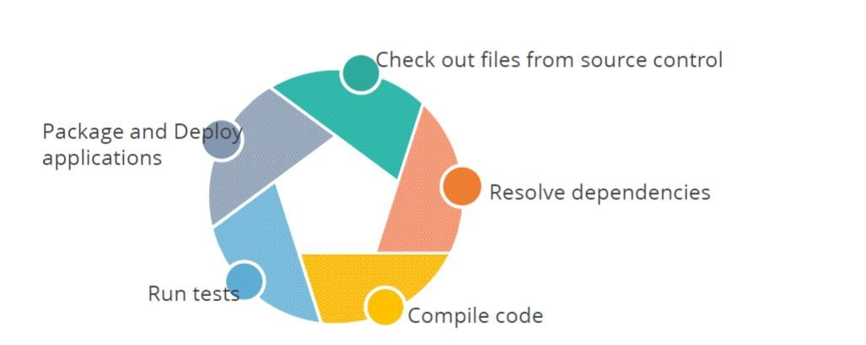
Build Tools are used to manage the Software Lifecycle
2

Slide 4
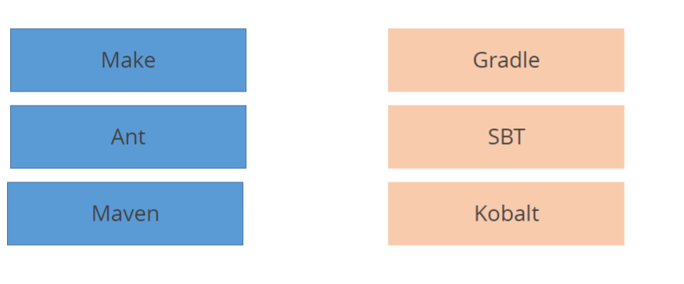
Various Build Tools
3

Slide 5
What is Maven
4
Maven was created to allow a developer to understand the state of a project quickly
Making the build process easy
Providing a uniform build system
Providing quality project information
Providing guidelines for best practices development
Allowing transparent migration to new features

Slide 6
Installing Maven
4
Maven can be installed on windows, Linux and MAC OS platforms.
To install maven the below steps needs to be performed:
Download maven and extract it
Add JAVA_HOME and MAVEN_HOME in environment variable
Add maven path in environment variable
Verify Maven

Slide 7
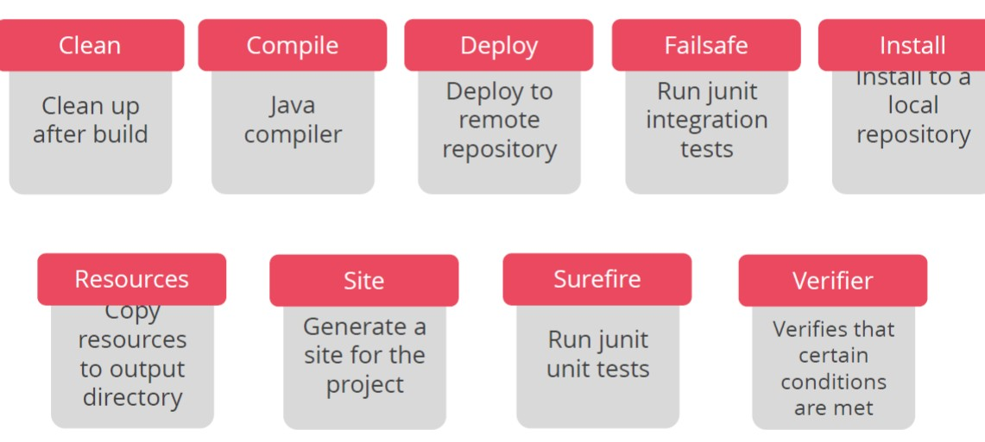
Maven – Core Plugins
5

Slide 8
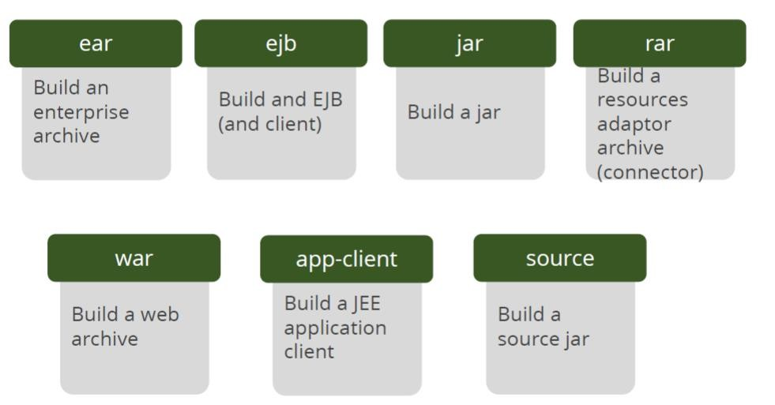
Maven – Packaging Plugins
6

Slide 9
Maven Reporting Plugins
7

Slide 10
Maven Archetypes
8
Archetype is a Maven project templating toolkit (mvn archtetype:generate)
Projects can be created from archetypes
An archetype is selected from a catalogue
The archetype is configured
•The project is created

Slide 11
Project Object Model (POM)
9
An XML representation of a Maven project
In the file pom.xml at the root of a project
A POM is declarative
Declares who, what, and where
A Maven project can simply be the pom.xml file
Most projects have code associated with them

Slide 12
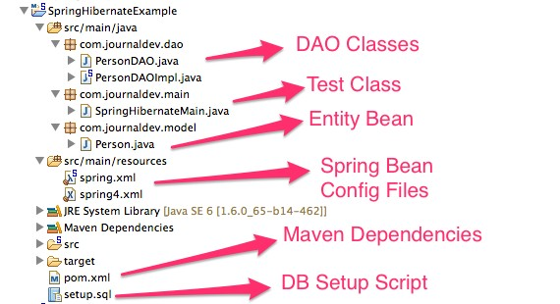
Maven in Spring Framework
10

Slide 13
POM Basics and Dependencies
11
The POM needs to define the Group ID, Artifact ID, and Version
The packaging should also be declared – the default is jar
Dependencies can be added to the POM file
Dependencies are downloaded from maven repositories and added to the build

Slide 14
Maven Build Lifecycle
11
There are three built-in build lifecycles: default, clean and site. The default lifecycle handles your project deployment, the clean lifecycle handles project cleaning, while the site lifecycle handles the creation of your project's web site.
Each of these build lifecycles is defined by a different list of build phases as given below
validate - validate the project is correct and all necessary information is available
compile - compile the source code of the project
test - test the compiled source code using a suitable unit testing framework. These tests should not require the code be packaged or deployed
package - take the compiled code and package it in its distributable format, such as a JAR.
verify - run any checks on results of integration tests to ensure quality criteria are met
install - install the package into the local repository, for use as a dependency in other projects locally
deploy - done in the build environment, copies the final package to the remote repository for sharing with other developers and projects.

Slide 15
Maven Build Lifecycle
11
Ref:https://maven.apache.org/guides/introduction/introduction-to-the-lifecycle.html

Slide 16
THANK YOU
15

